Slide 1
Getting SASsy with Enterprise Guide
Jerry Knutson, Research Analyst
Laura Wichman, Senior Research Analyst
McLennan Community College
Notes:
Background: McLennan has been using SAS since 2015. Laura since 2015 - Jerry since 2016
Data Sources:
-Libraries—Estudias, CBM Reports, Achieving the Dream Cohorts
-Ellucian/Colleague
-Anything we can download

Slide 2
Session Description
Do you ever get a request for data and end up doing part of the work manually? Do you find yourself copying and pasting tables from the Enterprise Guide (EG) results window into excel or word? Stop the nonsense!! Come by to see how to create and export SASsy reports using EG. Not only will it make your office more efficient, but it makes you look like you worked your SAS off!

Slide 3
Ground Rules…
Let’s set some ground rules for this presentation…
Stop us and ask questions while we are presenting
Share if you have a different way of doing something than we present
We are all here to learn, I am just here to start the conversation!

Slide 4
Question…
How many of you handle reports that you compile in one program and manually enter or copy/paste to another document?
Typical request steps:
Program in SAS and copy/paste the results to word
You spot an error…
Modify program in SAS and copy/paste the results to word
Crap…another error…
Modify program in SAS and copy/paste the results to word
Shoot that wasn’t what they really wanted
Modify program in SAS and copy/paste the results to word
Oh that look’s great…can we add this…

Slide 5
Notes:
Stop doing all of this! Why are you wasting time doing and redoing things when you can spend some time now to program SAS to do it and save yourself time later?

Slide 6
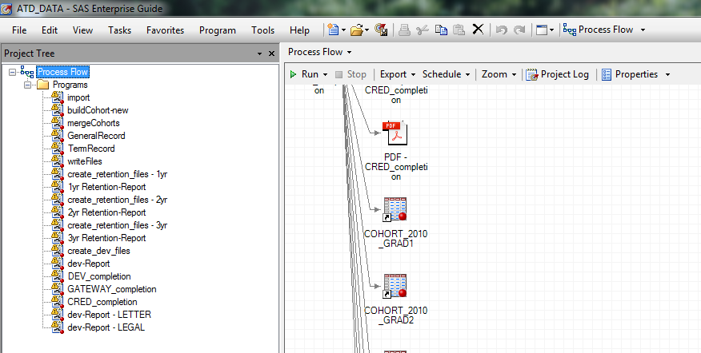
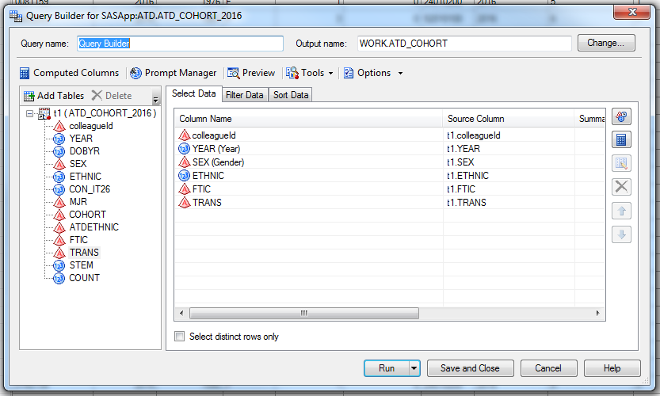
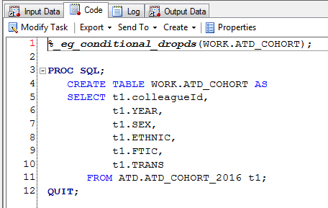
Notes:
The Basics:
Enterprise Guide lets you save all programs for a project in one file.
Drag and drop variables for queries
Copy code created from drag & drop and save into programs

Slide 7
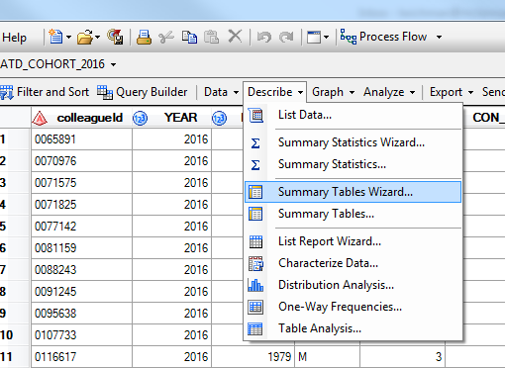
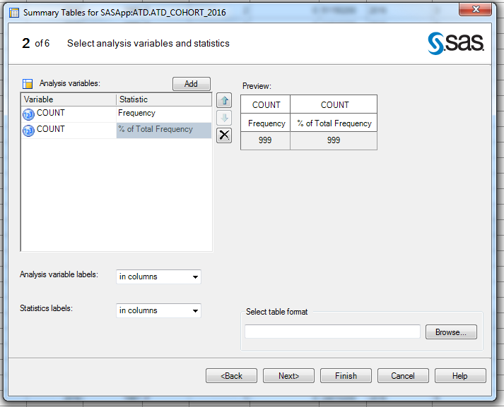
Tabulate Steps
Notes:
Open your dataset
Go to Describe > Summary Table Wizard (of Summary Tables if that is what you prefer)
Add your analysis variables

Slide 8
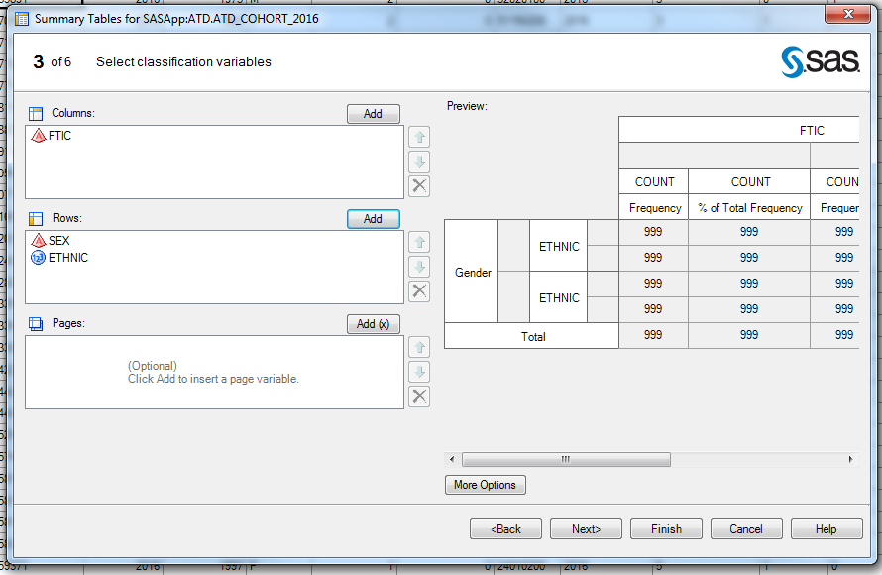
Tabulate Steps
Notes:
Add your column and row variables
You can make further customizations through ‘More Options’
Concatenate data rather than embed or cross tabulate
Finish

Slide 9
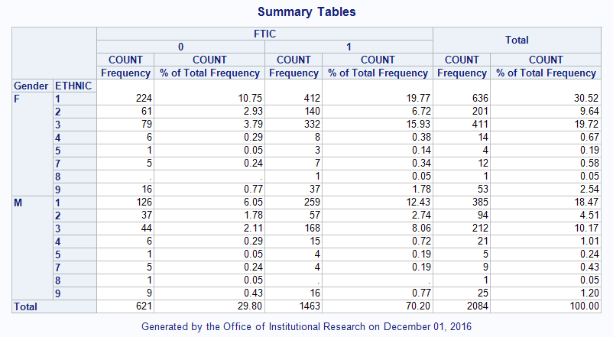
Tabulate Results
Notes:
Yay you have results!
Now what do you typically do…
Copy & paste it into Word or Excel

Slide 10
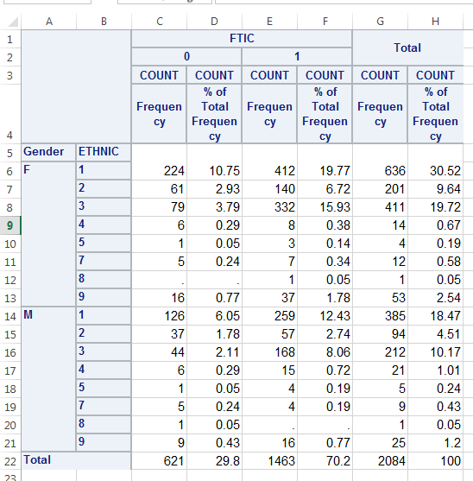
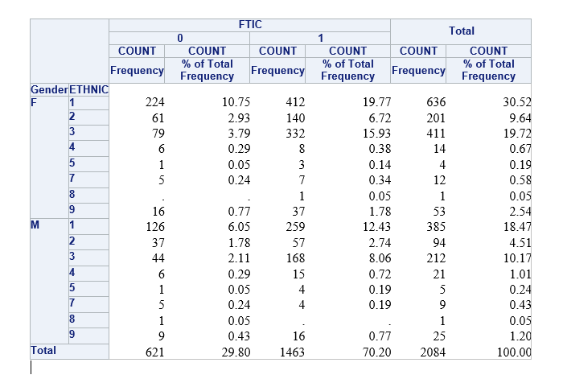
Paste into Excel or Word
Notes:
UGH!!! Now I have to format these columns and variable names.

Slide 11
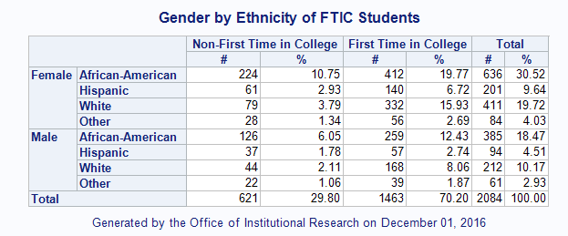
Notes:
With the effort you put into having to change the labels on the excel or word document, you can create this! Each time you run it to update the data, your labels and formats will automatically fill in for you.

Slide 12
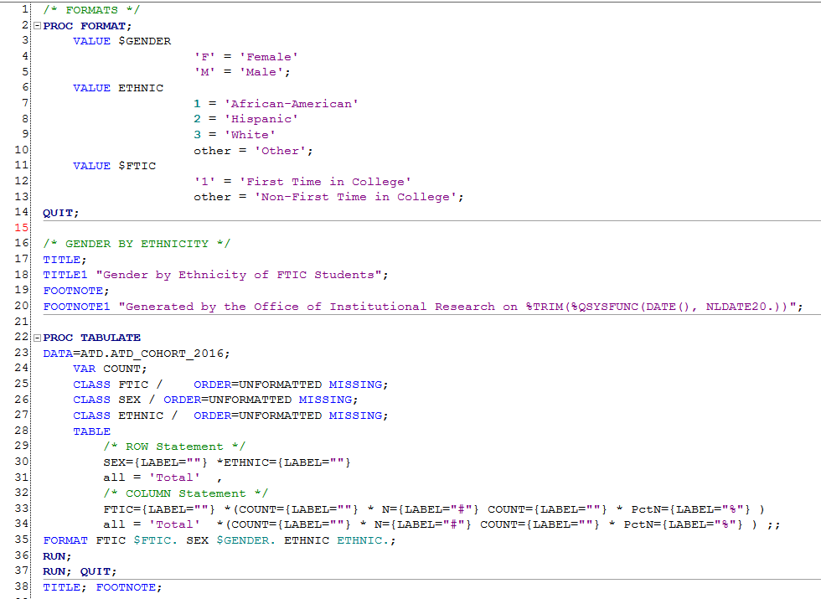
Notes:
Add Formats at the top to label your variables for you
Change column labels
Add custom title/footer

Slide 13
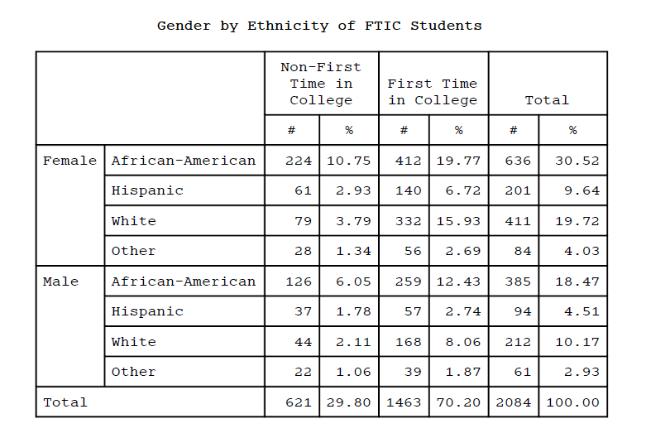
Export tabulate to pdf
Notes:
Add the ODS start and end statements and voila you have a pdf that is formatted and ready to go.
Of course you can go a step further on formatting and change backgrounds and column/row widths.

Slide 14
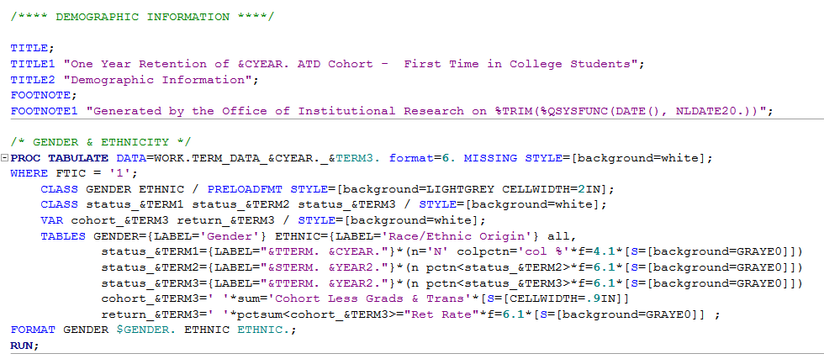
Notes:
This code sets the paper orientation to landscape and formats the tabulate with preloaded formats, backgrounds and cell widths…

Slide 15
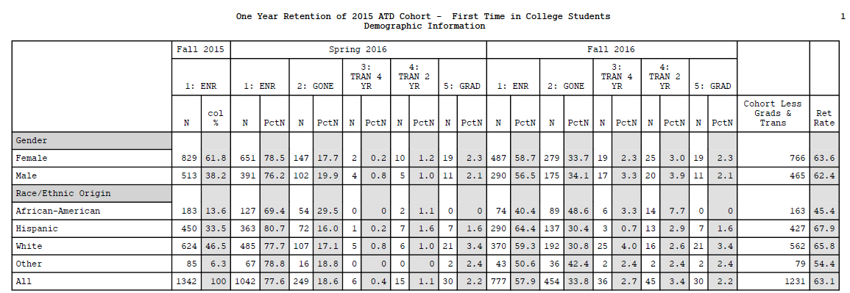
Notes:
To produce reports that automatically export to pdf when the program runs.

Slide 16
Institutional Pocket facts
http://mcciep.mclennan.edu/home/pdfs/pocketFacts.pdf
Tasked with creating an easy to read/use/carry sheet that could be easily accessed with commonly asked questions:
Enrollment Trends
Retention Trends
Developmental Education Need
Demographics
Financial Aid
Veteran Information
Graduation Rates
Dual Credit
Employee Numbers
Cost of Attendance Comparison
Taxes, Revenue/Expenses
Licensure and Placement Rates (LBB)
University Center Enrollment
University Center
Glossary of Terms
Notes:
Our office was tasked to create an easy to use and read sheet of information that could easily be carried and referred to. There was tons of data that needed to be on the sheet, so we designed a double sided, foldable ‘pocket fact sheet’ that can easily be placed in a pocket, wallet or purse to quick access to common questions.

Slide 17
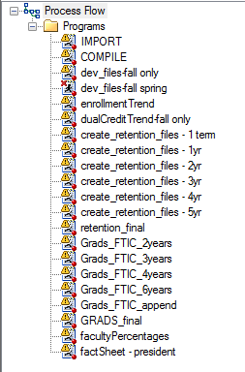
Pocket Facts Program
Every step is completed in Enterprise Guide
Importing
Compiling
Exporting

Slide 18
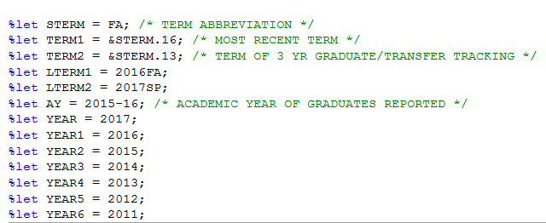
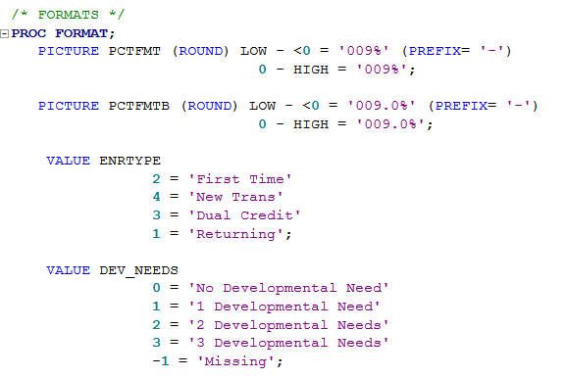
Notes:
The export file takes all the datasets from the compiling process/programs and displays the final tables.
Contains:
Macros
Custom Template
Formats

Slide 19
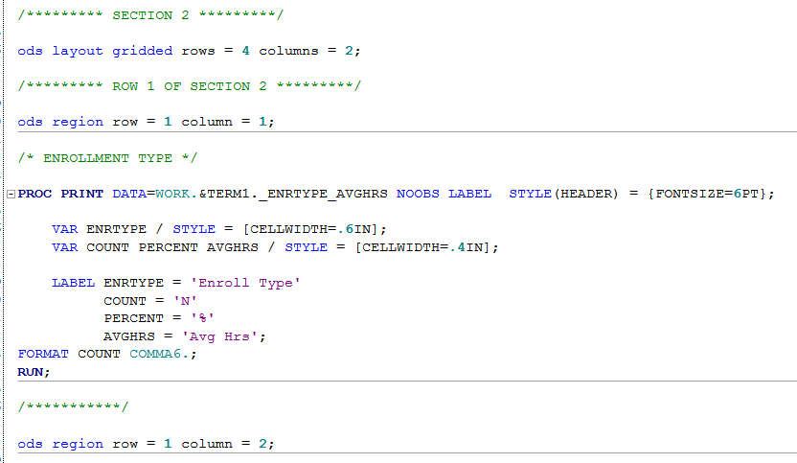
Notes:
ODS statement
Custom options: pape rsize and margins
Regions
Set layout gridded
Set regions

Slide 20
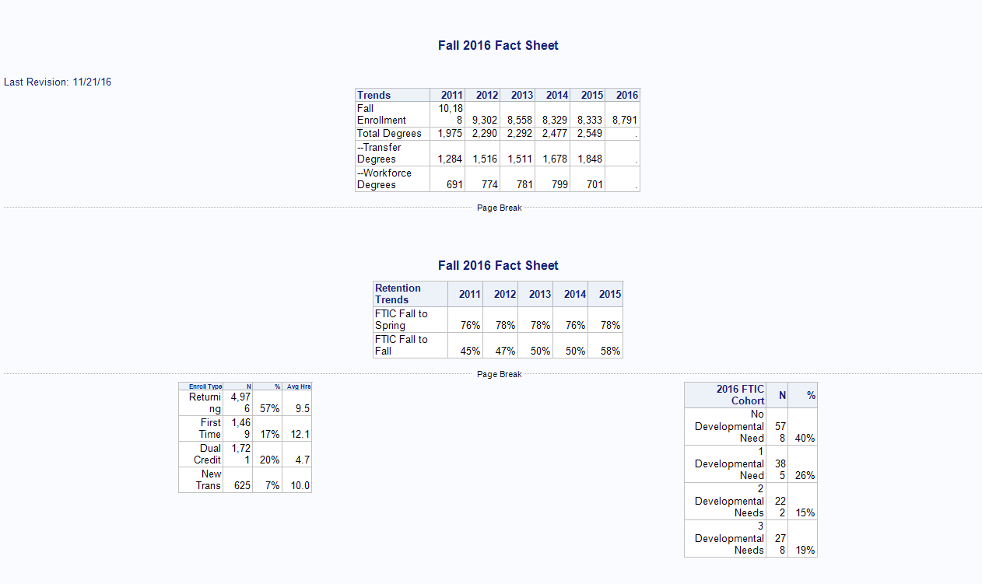
Notes:
When I run the file in EG the results window looks very different from what the final product looks like

Slide 21
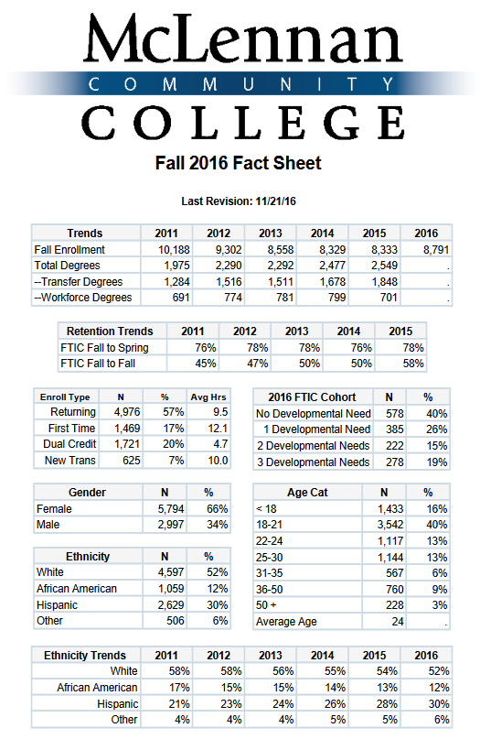
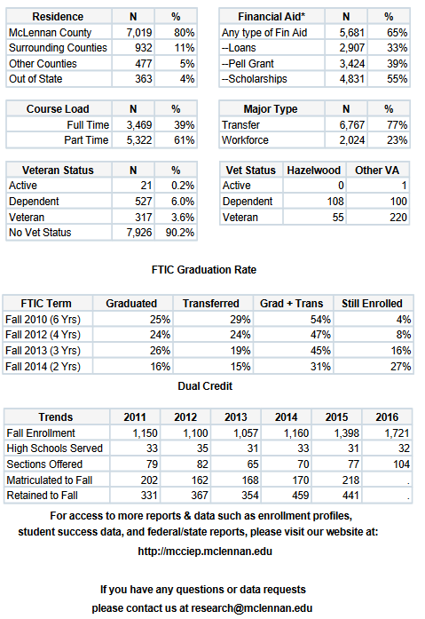
Notes:
Since it is legal size I cut the front into two pictures so you could see the data and details

Slide 22
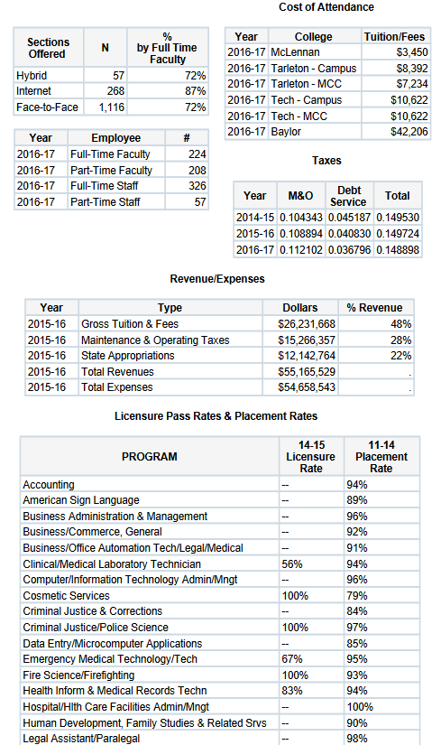
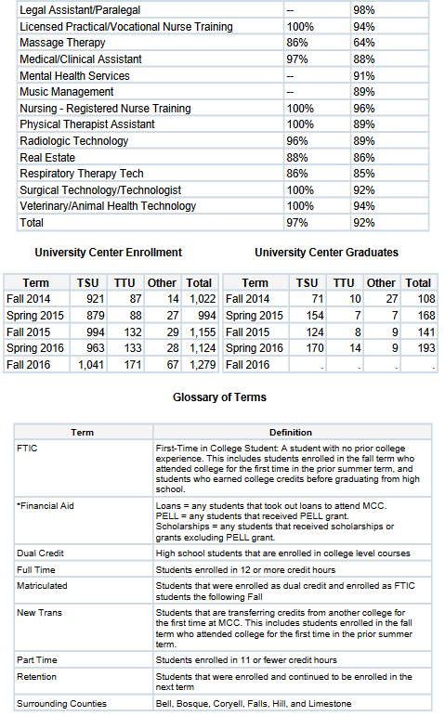
Notes:
And I did the same on the back of the sheet

Slide 23
Prompt driven programs

Slide 24
Setting up a prompt
Notes:
This is one of the option in the task panel where the servers are referenced

Slide 25
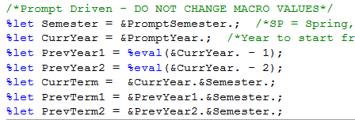
Setting up the details
Notes:
You can set up specific values – this helps with typos later. You can also set a default value.
In the usage, it behaves exactly like other macro values

Slide 26
Section Reports to excel & pdf

Slide 27
Section Reports to excel & pdf by daypart

Slide 28
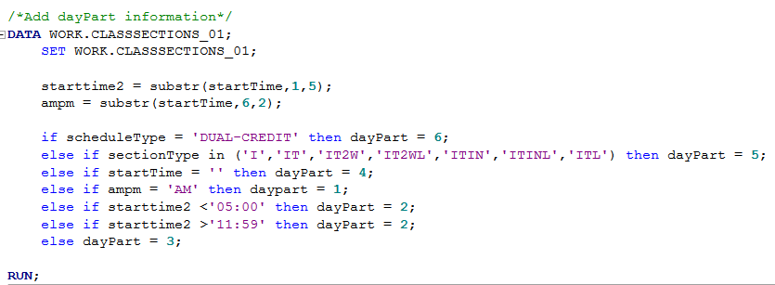
How to group by daypart
Notes:
The format for the DayPart makes sure that the groupings display in the order I want them to… Numerically. The format is processed (substituted) at run time to display the appropriate text
Adding the daypart information is in the hierarchy it needs to be in to make sure every record gets a value, and gets the correct one. The else if statements make it a one-evaluation-per-record event.

Slide 29
Dayparts in PDF

Slide 30
Dayparts in pdf – part 2
Notes:
This is two different tabulates because it is two tables… one for a total, one for the daypart breakdown

Slide 31
Dayparts in Excel
Notes:
Tabs. One per dayPart

Slide 32
ODS Excel
Notes:
Saves as XML no matter the extension used.
It will open in Excel, but will give you the security warning that the file type detected does not match the extension.

Slide 33
Dayparts in Excel

Slide 34
ODS statements - Excel
ods tagests.ExcelXP file = “\\path\filename.xml” options (orientation = ‘Landscape’);
ods tagsets.ExcelXP close;
Notes:
This saves as XML, regardless off the extension used. It will generally open in Excel by default.

Slide 35
“Secret” conversion to XLS(x)

Slide 36
How to run…
Notes:
This takes an environmental fix to allow – Problem Note: 41058.

Slide 37
ODS statements - PDF
ods pfd file = “\\path\filename.pdf” notoc style=minimal; options nonumber nodate;
ods pdf close;
Notes:
Notoc = No Tables of Contents that is there by default
NoNumber = no page numbers that are there by default
Nodate = no date in header that is there by default

Slide 38
ODS statements - RTF
ods rtf file = “\\path\filename.rtf” style=minimal;
ods rtf close;

Slide 39
