Slide 1
Say Goodbye to the American Dream
Lou Guthrie
Director
National Higher Education Benchmarking Institute

Slide 2
Session Agenda
What is the American Dream
Equality of Opportunity Project
Building a Custom Report

Slide 4
What is the American Dream?
"The American Dream is that dream of a land in which life should be better and richer and fuller for everyone, with opportunity for each according to ability or achievement.“
--James Truslow Adams, Epic of America, 1931
"... a focus on more of what really matters, such as creating a meaningful life, contributing to community and society, valuing nature, and spending time with family and friends.“
--Center for a New American Dream

Slide 5
What is social mobility?

Slide 7
http://www.equality-of-opportunity.org/

Slide 10
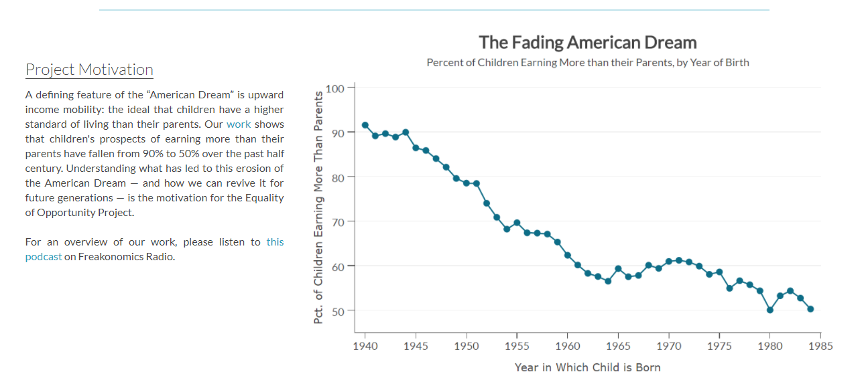
http://www.equality-of-opportunity.org/

Slide 11
Household Income Quintiles

Slide 12
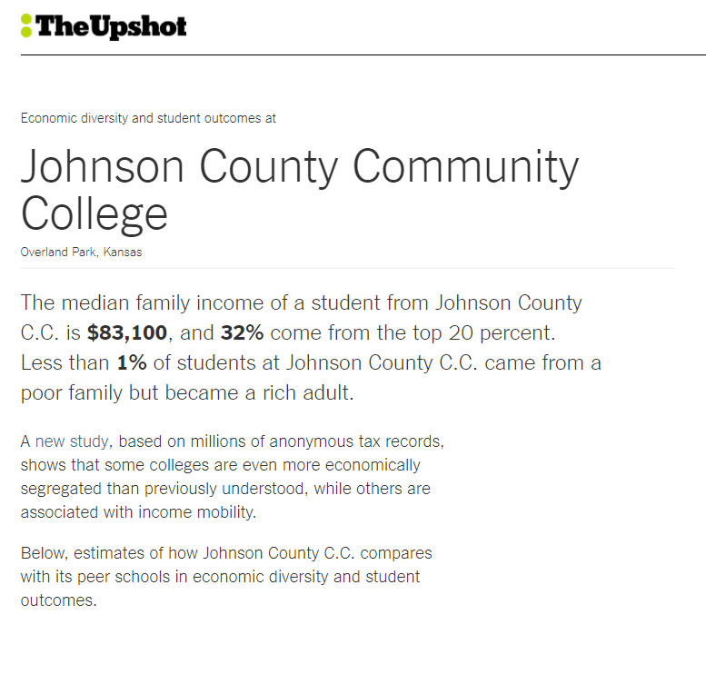
https://www.nytimes.com/interactive/projects/college-mobility/

Slide 13
Social Mobility and the NCCBP

Slide 14
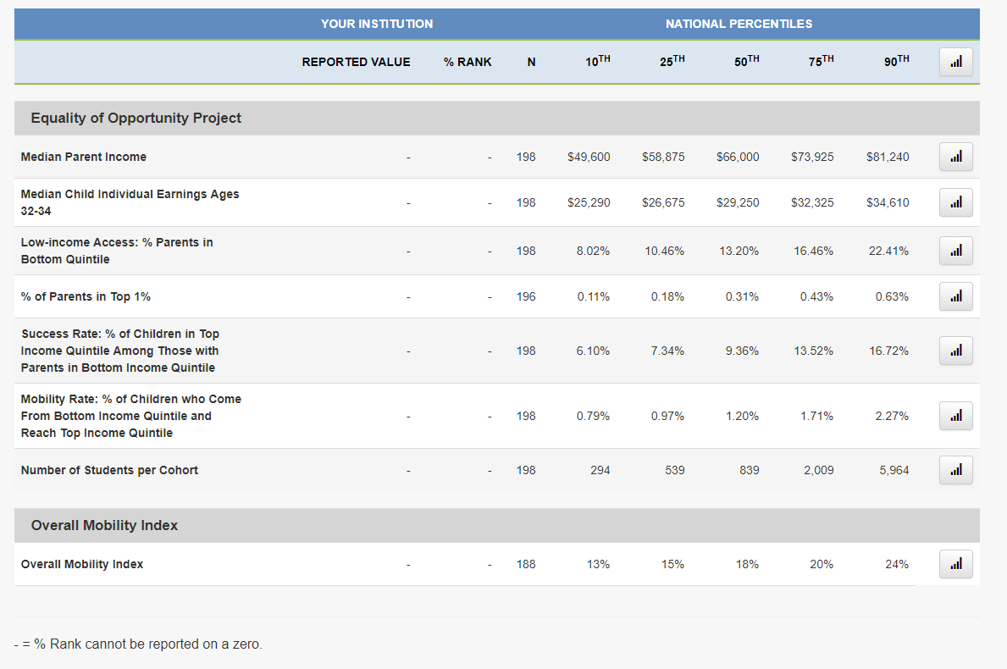

Slide 15
Upward Mobility Rate: % of Children who Come From Bottom Income Quintile and Reach Top Income Quintile

Slide 16
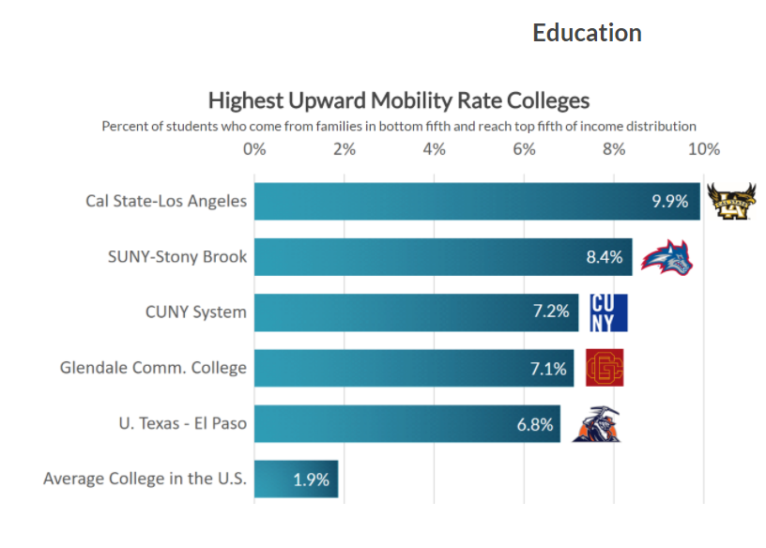
UPWARD MOBILITY

Slide 17
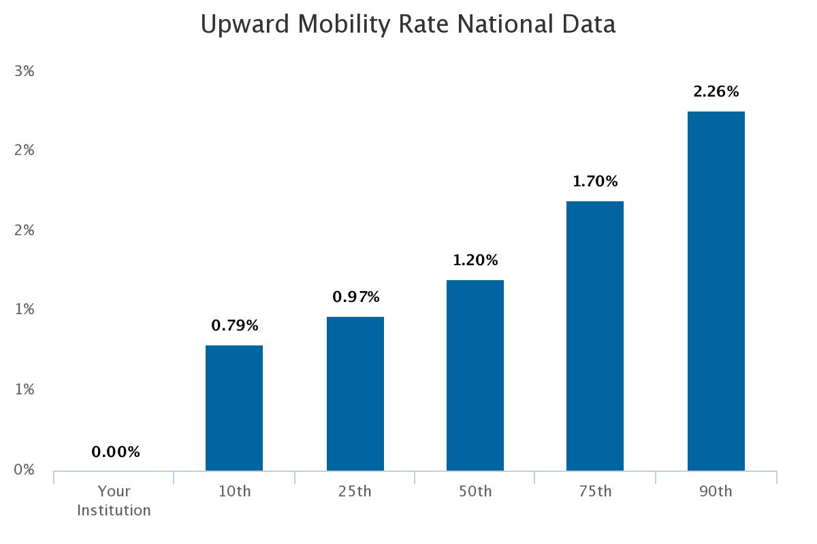

Slide 18
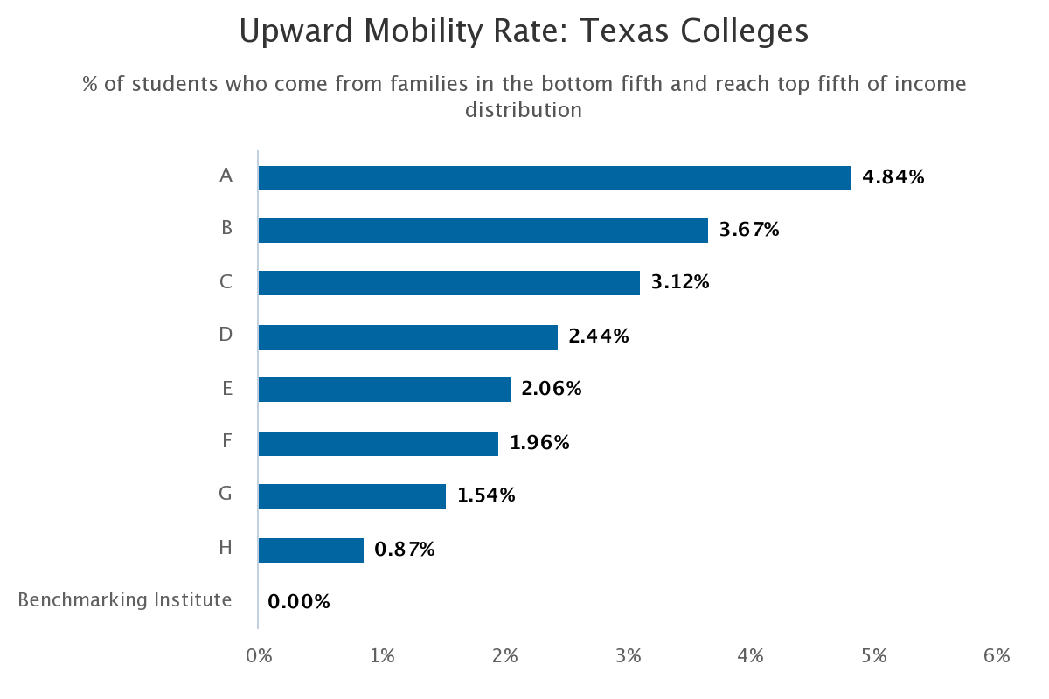
National 75th%: 1.70%
National Median: 1.20%
National 25th%: .97%

Slide 19
% of students who come from families in the bottom fifth and reach top fifth of income distribution.

Slide 20
Overall Mobility Index:
% of students from the college that moved up two or more income quintiles (rounded from longitudinal sample)

Slide 21
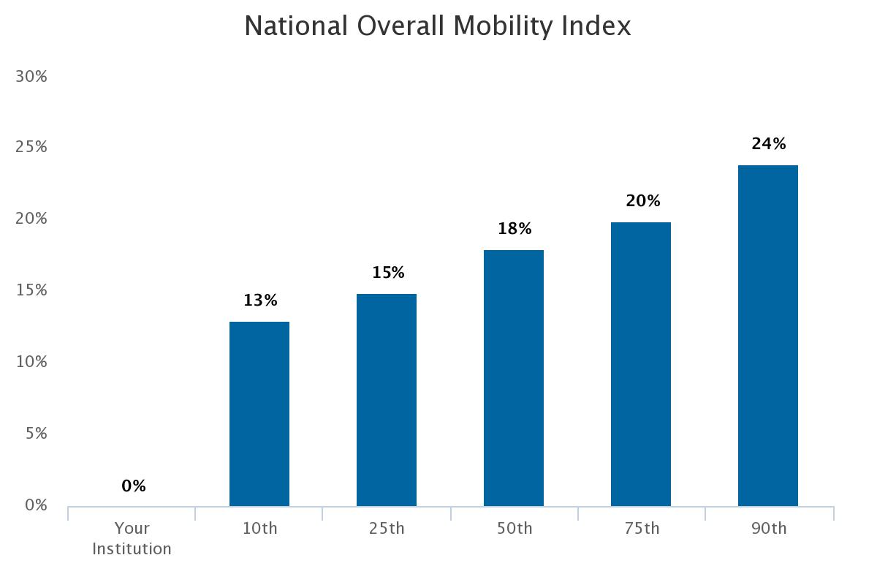

Slide 22
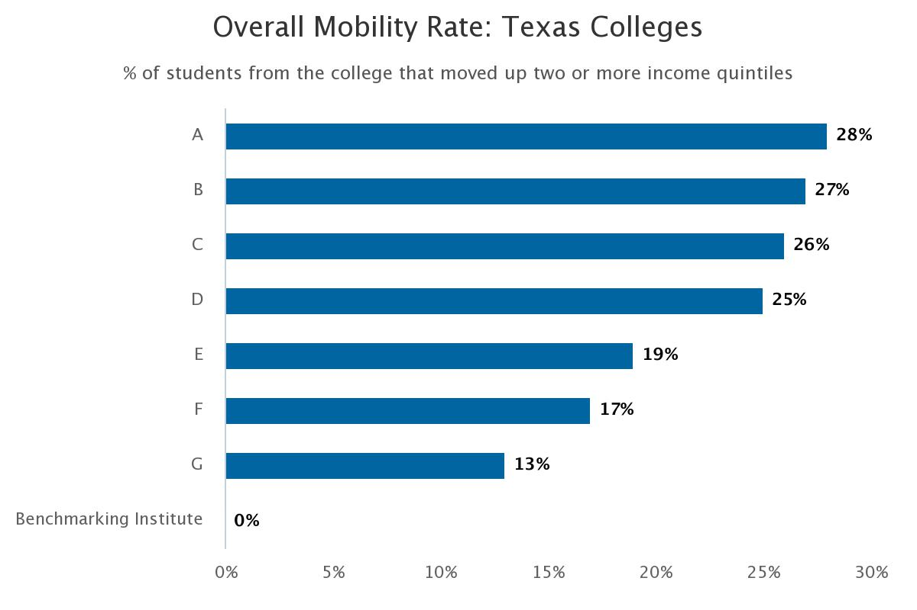
National 90th%: 24%
National 75th%: 20%
National Median: 18%

Slide 23
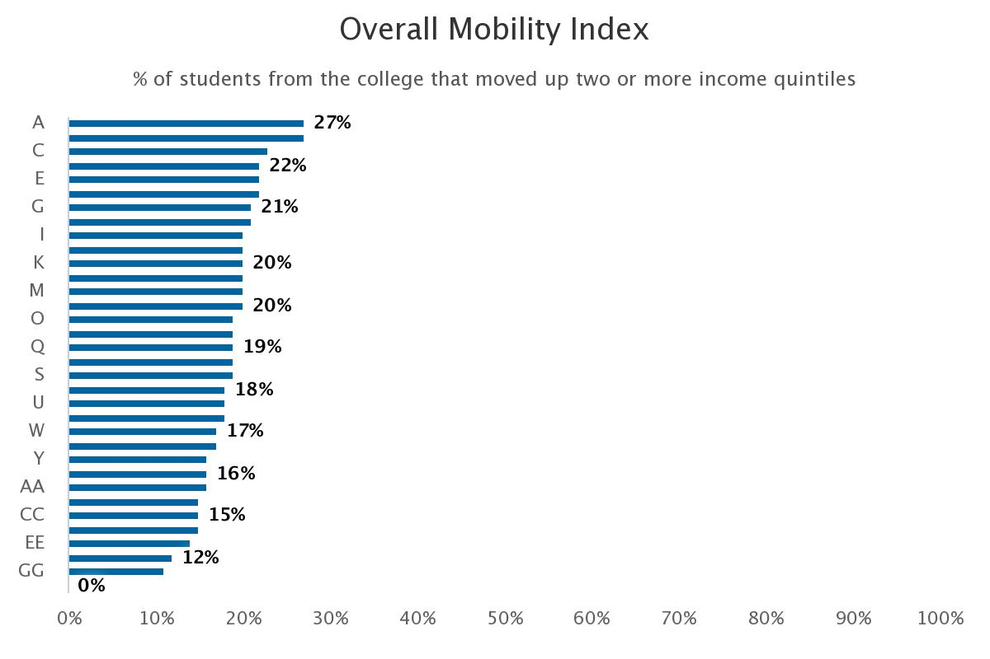
MidAIR Peer Group
National 90th%: 24%
National 75th%: 20%
National Median: 18%

Slide 24
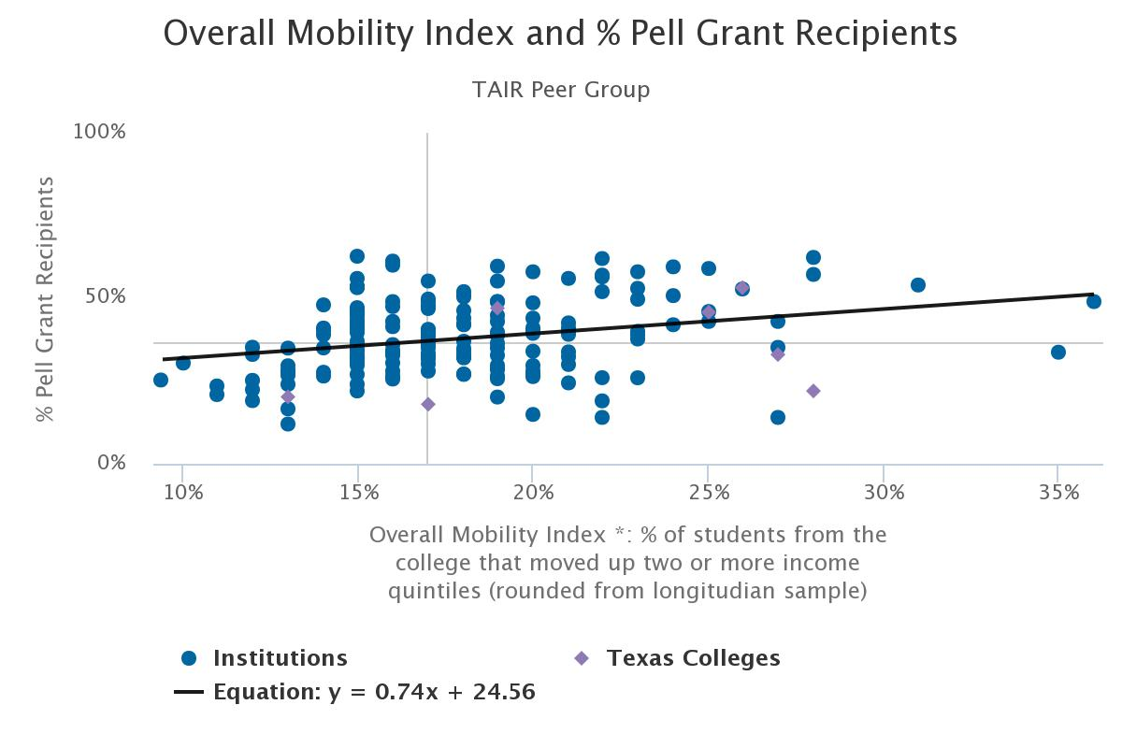

Slide 25
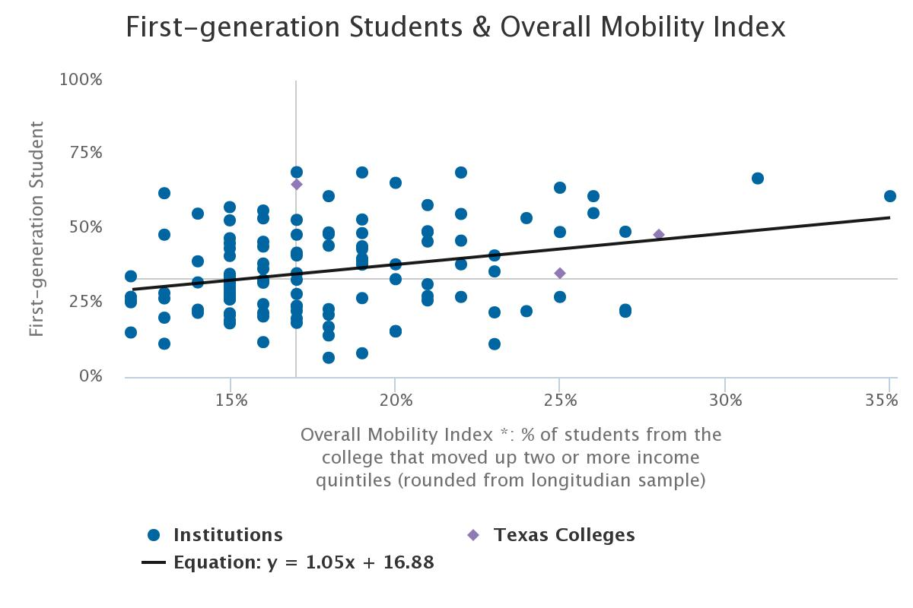

Slide 26
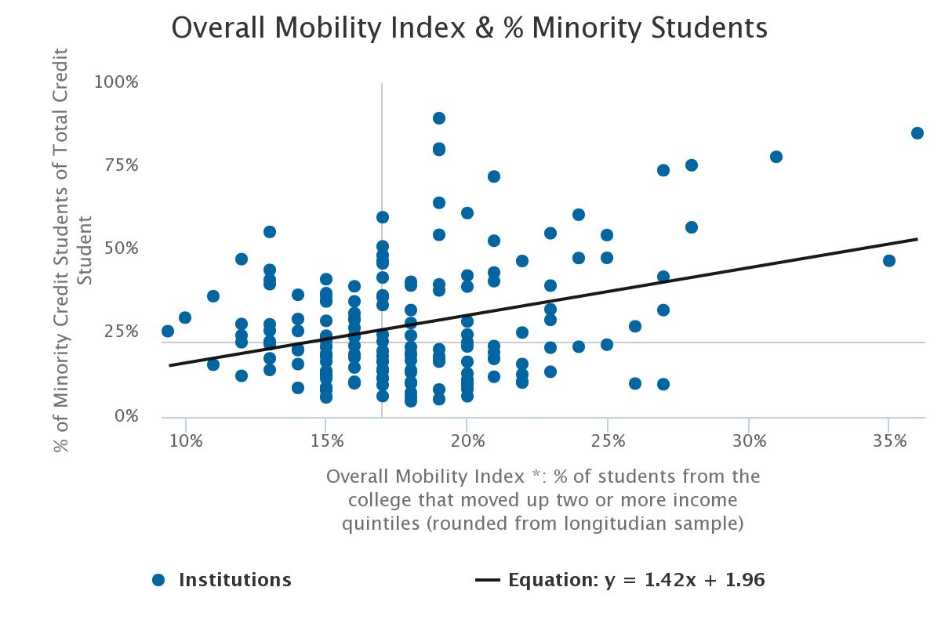

Slide 27
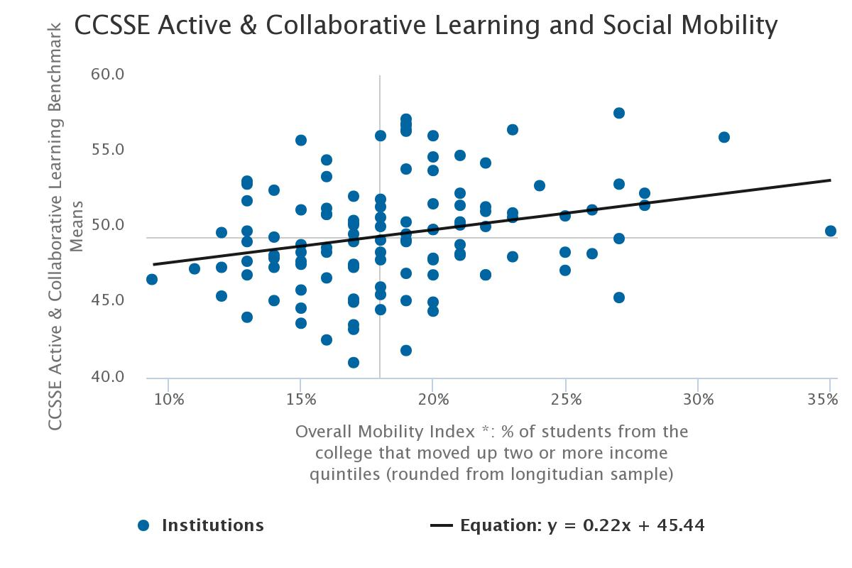

Slide 28
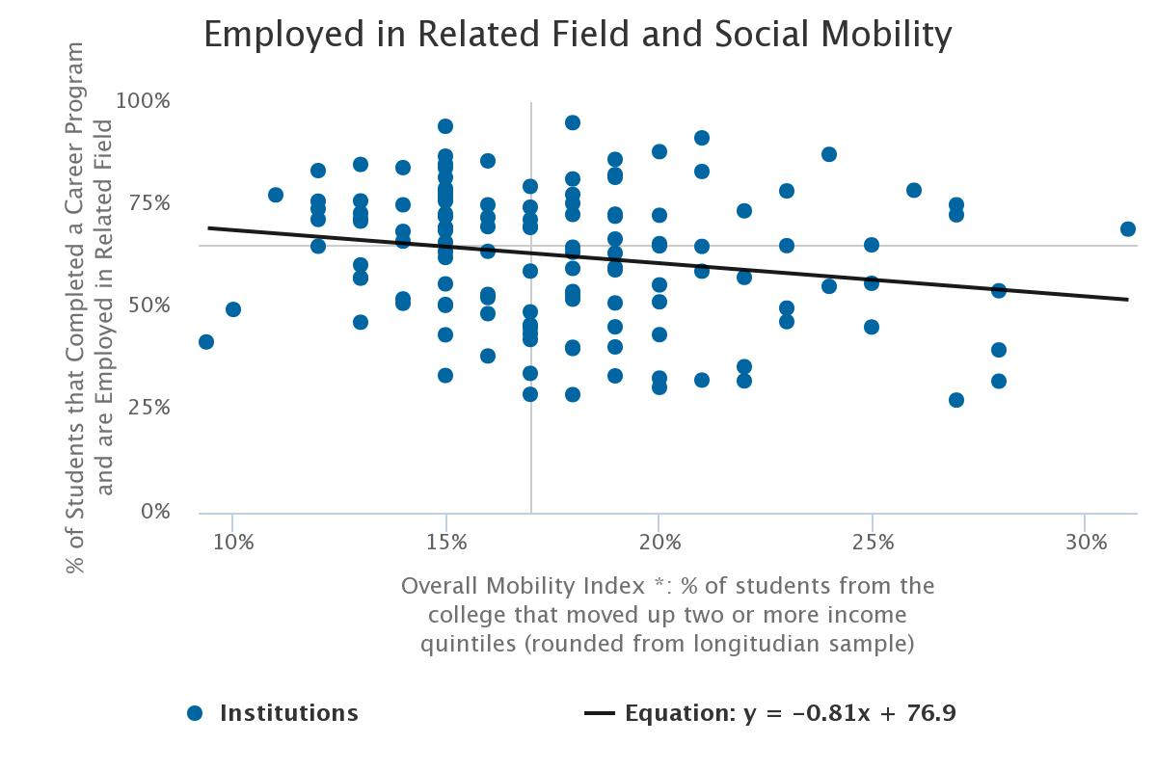

Slide 29
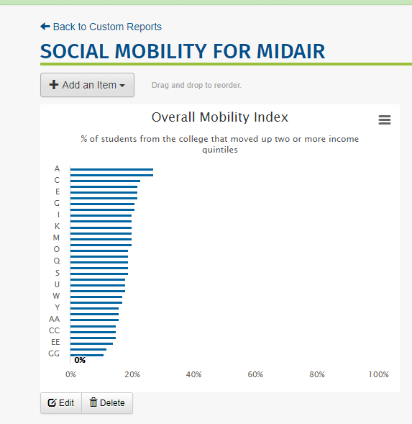
Custom Reports:
Sign in to NCCBP
Go to Reports menu
Drop down and click on Custom Reports
I have copied a custom reports to all the MidAIR peer colleges

Slide 30
Conclusions:
Social mobility may be another way to evaluate the success of your college in preparing students for the future.

Slide 32
Keep up with the Benchmarking Institute and all of our projects by joining us on LinkedIn and following us on Twitter.
@EdBenchmark
Join the National Higher Education Benchmarking Institute Group

Slide 33
Lou Guthrie
913-469-8500, ext. 4019
louguthrie@jccc.edu

